Slide 1


Implementing Push Notification Support in your Android Application
Keith Wedinger
Director, Technology Solutions

Slide 2



Slide 3


Slide 4
Agenda
Introduction
Prerequisites
Set Up Google Play Services SDK
Create Google API Project
Get a Google Service Configuration File
Add Google Play Services Library
Update the App's Manifest
Check for Google Play Services Availability
Register Your App with GCM
Implement Services
Process Notification Data in Activity
Testing Without a Server
Test API Key and Registration ID
Additional Info and Questions

Slide 5
About Me
Over 25 years experience designing, developing and delivering high quality software solutions for several companies including Lexmark, Diebold, Limited Brands, Sterling Commerce and IBM. Completed a PhoneGap / web technology based Android mobile app solution to help automate the workflow for client's 1,200 service technicians. Also completed push notification support for a client’s native Android app that allows the client’s employees to be notified of new equipment alarms. Presented "Real World Mobile App Development with PhoneGap" at Columbus Code Camp, StirTrek and M3. Presented "Hybrid or Native - What Should Be Your Mobile Strategy and Why" at M3. Currently working on the design and architecture of a mobile and server vehicle health management solution for a large trucking company.

Slide 6
About Leading EDJE
At Leading EDJE solving problems is our sweet spot! We are an IT Consulting firm specializing in building custom application solutions utilizing leading edge technologies. We have a unique culture which promotes high positive energy with an entrepreneurial spirit. Our firm is made of exceptionally talented individuals who deliver exceptional results. We choose to live our lives by making the right decisions as opposed to the "right now" ones.

Slide 7
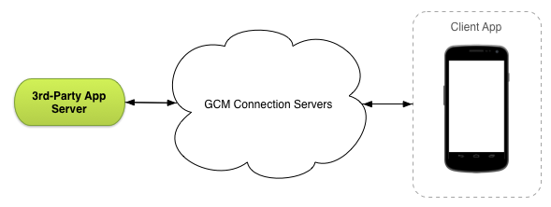
Introduction
Google Cloud Messaging (GCM) is a free service that allows you to send data from your server to your Android application
GCM service handles all aspects of message queueing and delivery to target app running on the target device
Lightweight messages telling your app there is new data to be fetched from your server
Messages containing up to 4kb of payload data

Slide 8
Prerequisites
Development
Google account to create Google API project
Android development environment
Android SDK: http://developer.android.com/sdk/index.html
IDE
IntelliJ IDEA: http://www.jetbrains.com/idea/
Android Studio: http://developer.android.com/sdk/index.html
Google Play services SDK
Required to use the GoogleCloudMessaging methods
Test
Compatible Android device that runs Android 2.3 or higher and includes Google Play Store
Android emulator with an AVD that runs the Google APIs platform based on Android 4.2.2 or higher

Slide 9
Set Up Google Play Services SDK
Start the Android SDK Manager
Install the Google Play services SDK
To test on emulator
Expand platform for API 19 or higher
Install Google APIs (x86 System Image)
Create a new AVD with Google APIs as the platform target
DEMO

Slide 10
Create Google API Project
Open the Google Developers Console
https://console.developers.google.com/project
Click Create Project
Enter the project’s name
IMPORTANT: Note the project number
Used later as GCM sender ID inside app when registering with GCM
DEMO

Slide 11
Create Google API Project
Obtain the Server API key
Click Credentials under APIs & auth in left sidebar
Under Public API access, click Create new Key
In Create a new key dialog, click Server key
In Create a server key and configure allowed IPs dialog, leave entry box blank and click Create
IMPORTANT: Note the API key
Used by server as authorization key in HTTP Authorization header when posting notification messages
DEMO

Slide 12
Get a Google Service Configuration File
Enables Google Cloud Messaging service for your app
Parsed by Google Services plugin during app build
Open Get a configuration file
https://developers.google.com/cloud-messaging/android/client#get-config
Click GET CONFIGURATION FILE
Choose existing Google API project name in App name drop down
Enter Android package name for your app
Click CONTINUE TO Choose and configure services
Click ENABLE GOOGLE CLOUD MESSAGING
Click CONTINUE TO Generate configuration files
Click Download google-services.json
This will get placed in root directory of your project
DEMO

Slide 13
Add Google Play Services Library
Android build system based on Gradle
Much simpler than old Eclipse model
Inside build.gradle, add the following dependencies
dependencies { compile 'com.android.support:appcompat-v7:22.+' compile 'com.google.android.gms:play-services:7.5+' }
Gradle build will run tasks to get dependencies from Android SDK

Slide 14
Update the App's Manifest
Add Permissions
com.google.android.c2dm.permission.RECEIVE | App can register and receive messages
android.permission.INTERNET | App can send registration ID to the 3rd party server
android.permission.GET_ACCOUNTS | Access to Google account, only if Android version < 4.0.4
android.permission.WAKE_LOCK | App can keep process from sleeping when message is received
android.permission.VIBRATE | Notifications cause device to vibrate
applicationPackage.permission.C2D_MESSAGE | Prevent other apps from registering/receiving this app’s messages.
Define GcmReceiver to receive GCM messages
Define GcmListenerService implementation for handling GCM messages
Define IntentService implementation for GCM registration
Define InstanceIDListenerService implementation for handling registration token updates
Code walkthrough

Slide 15
Check for Google Play Services
Apps relying on Google Play Services should check for compatible version
Typically done in following main activity methods
onCreate() – ensures app cannot be used without successful check
onResume() – ensures check is done when user returns to the app
App can call GooglePlayServicesUtil.getErrorDialog() to:
Download APK from Google Play Store or
Enable it in device settings
Code walkthrough

Slide 16
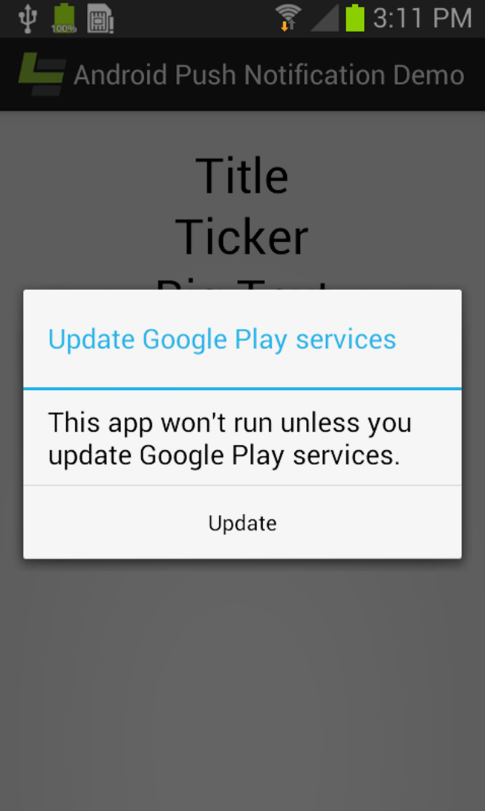
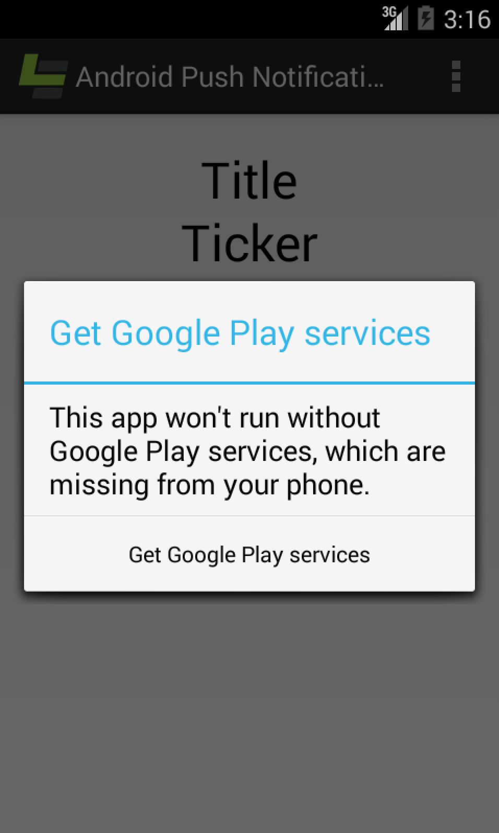
Check for Google Play Services

Slide 17
Register with GCM
App must register with GCM before it can receive messages
Google provides Instance ID API to register with GCM
instanceID.getToken
Should not be done on the main thread
Receives registration token from GCM
Used by server to send notifications to that device
Code walkthrough

Slide 18
Implement Services
Extend InstanceIDListenerService
Override onTokenRefresh() to process GCM registration token updates
Extend GcmListenerService
Override onMessageReceived() to receive and process GCM messages
Use Notification.Builder to build notification
Use NotificationManager to send notification
Code walkthrough

Slide 19
Process Notification Data in Activity
Store data inside Intent extras
Process data in two places
onCreate() if activity was destroyed / recreated
onNewIntent() if activity still exists
Requires Intent to have FLAG_ACTIVITY_SINGLE_TOP flag to be set
Code walkthrough

Slide 20
Testing Without a Server
Server implementation not required
Any tool capable of sending HTTPS POST requests will work
Examples:
curl
Hurl.it - http://www.hurl.it/
Dev HTTP Client (DHC) - Google Chrome App
Postman - Google Chrome App

Slide 21
Test API Key and Registration ID
Run this command, all on one line
curl --header "Authorization: key=<API Key>" --header Content-Type:"application/json" https://android.googleapis.com/gcm/send -d "{\"registration_ids\":[\"<Registration ID>\"]}"
Valid server API key and device registration ID returns:
{"multicast_id":7234249251933638557,"success":1,"failure":0,"canonical_ids":0,"results":[{"message_id":"0:1397573613153828%b1013b1cf9fd7ecd"}]}
Invalid server API key returns HTTP status code 401
Invalid device registration ID returns:
"failure":1, results":[{"error":"InvalidRegistration"}]
DEMO

Slide 22
Additional Info
GitHub repo:
https://github.com/LeadingEDJE/MobilePushNotification
Google Cloud Messaging for Android
http://developer.android.com/google/gcm/index.html
Setting up Google Play Services
http://developer.android.com/google/play-services/setup.html
Android Build System Overview
http://developer.android.com/sdk/installing/studio-build.html
DHC REST HTTP API Client
https://chrome.google.com/webstore/detail/dhc-rest-http-api-client/aejoelaoggembcahagimdiliamlcdmfm?hl=en
Droid@Screen
http://droid-at-screen.ribomation.com/

Slide 23
Questions
My contact info:
keith.wedinger@leadingedje.com
Twitter: @jkwuc89
GitHub: https://github.com/jkwuc89
http://leadingedje.com

